Slide 1

Social Network Analysis
Network growth

Slide 2


Rise of Online Social Networks
Online social networks growing rapidly year-by-year
Their sizes are huge
In 2014, Facebook possessed 1.39 billion active users and 400 billion friendship links
March 2015, Twitter has 288 million active users and 60 billion followers
Such huge volume of these online networks restrict the active research with real social networks
https://ourworldindata.org/rise-of-social-media

Slide 3
Synthetic Networks
Generated using theoretical network models
Often possesses strong underlying mathematical foundation
Often can simulate important real-world network characteristics
Help getting insights of the real-life networks
Allow experimentation through simulation when real networks are unavailable
can establish network insights on concrete theoretical foundations

Slide 4
Properties of Real-world Networks
High average local clustering coefficient
Small-world property
Scale-free property

Slide 5
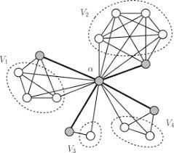
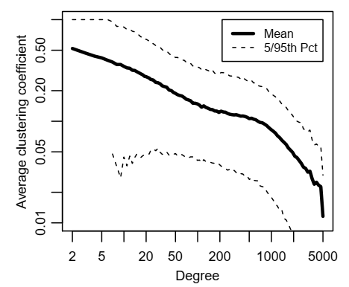
High Average Local Clustering Coefficient
Neighbors of a node tend to be highly connected with each other at individual level
In Facebook social graph, for users with 100 friends have average local clustering coefficient of 0.14
For a graph of 150 million nodes, the number is unexpectedly high
Clustering coefficient of Facebook Social Graph
Ugander et al. (2011)
https://www.sciencedirect.com/science/article/pii/S0166218X16304589

Slide 6
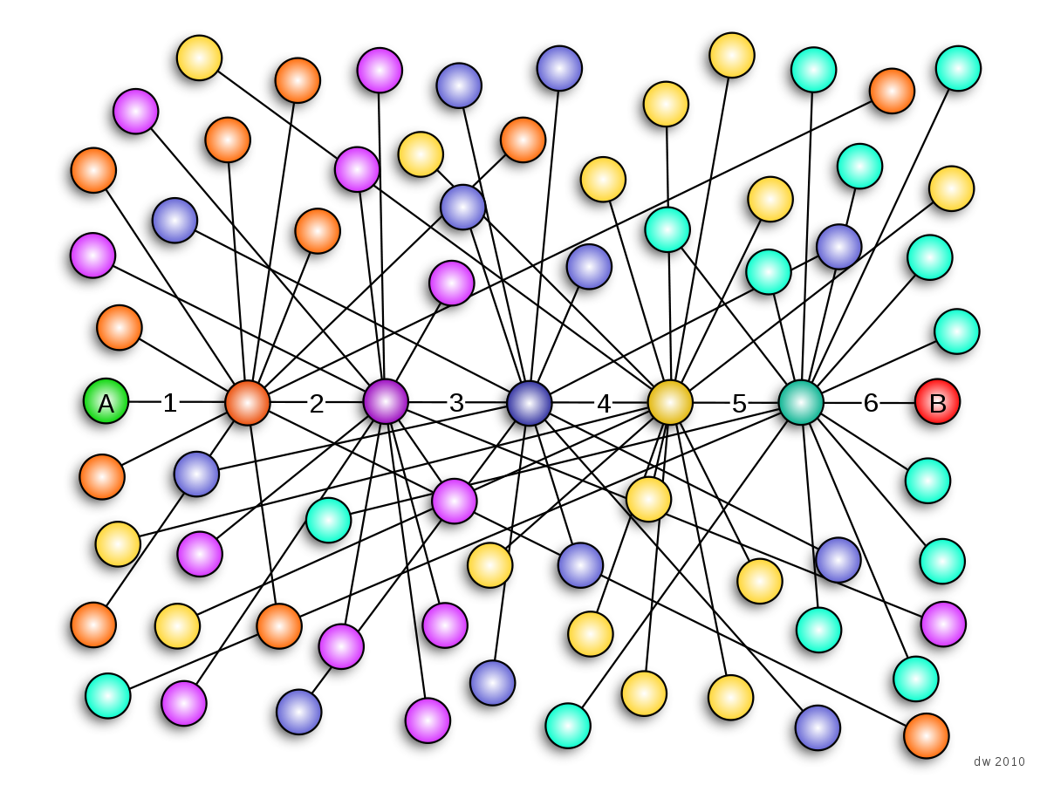
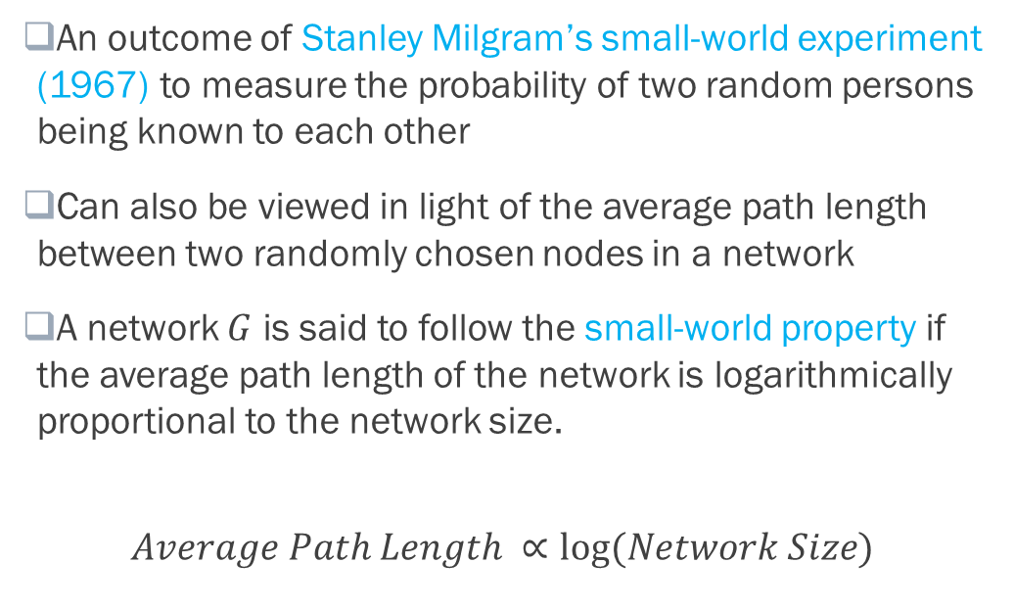
Small-world Property
An outcome of Stanley Milgram’s small-world experiment (1967) to measure the probability of two random persons being known to each other
Can also be viewed in light of the average path length between two randomly chosen nodes in a network
A network $G$ is said to follow the small-world property if the average path length of the network is logarithmically proportional to the network size.
$$Average Path Length ∝log⁡(Network Size)$$
The "six degrees of separation" model
https://en.wikipedia.org/wiki/Small-world_experiment

Slide 7
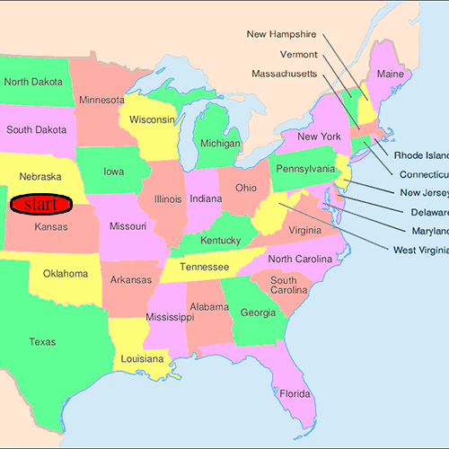
Six Degrees of Separation: Milgram’s Small-World Experiment
Source cities: Omaha, Nebraska, and Wichita, Kansas
Destination city: Boston, Massachusetts
Information packets sent initially to random persons in Omaha/Wichita
Recipient was to forward the letter
directly to target, if she knew the target personally
Else to some friend/relative who more likely to know the target
64 out of 296 letters eventually reach the target contact
Number of intermediates among the traversal path chains:
Maximum: 11 Minimum: 1 Median: 5.2 (≈6)
A possible path of a letter
https://en.wikipedia.org/wiki/Small-world_experiment

Slide 8
Small-world of Social Media!!!
average chain of contacts in Microsoft Messenger was 6.6 people [Leskovec and Horvitz 2007]
Average distance between two random Facebook users in 2011 was 4.74 with 3.74 intermediaries [Four Degree of Separation by Backstrom et al. (2012)]
Average distance between two random Facebook users in 2016 was 4.57 with 3.57 intermediaries [Repeat Experiment by Facebook in 2016]

Slide 9
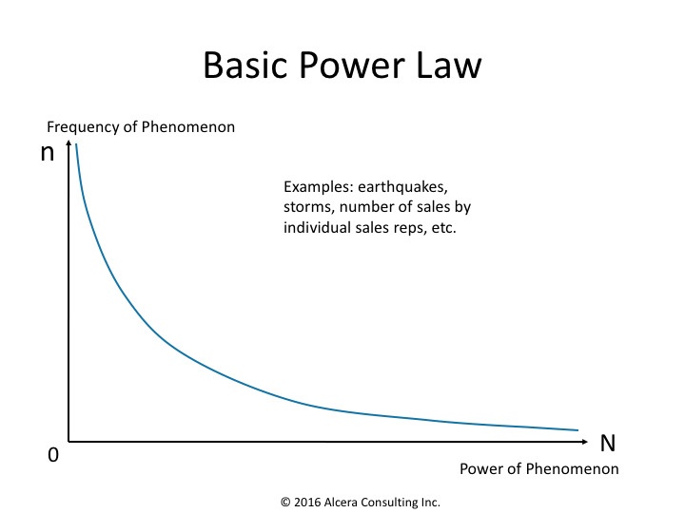
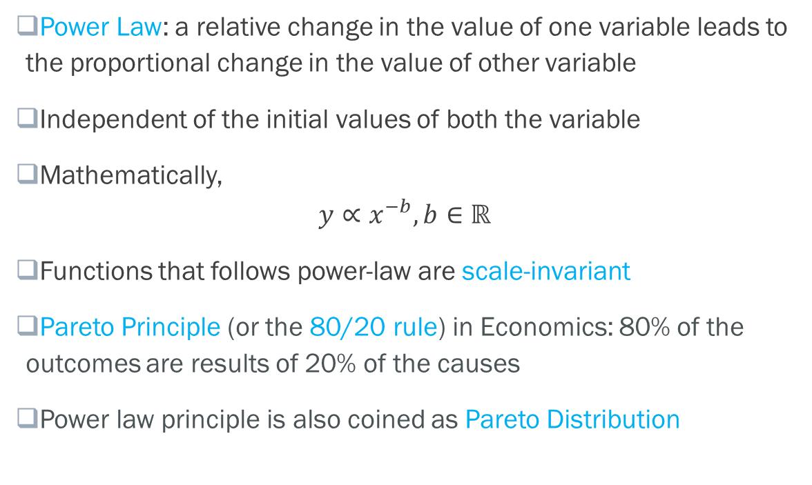
Scale-free Property: Power Law
Power Law: a relative change in the value of one variable leads to the proportional change in the value of other variable
Independent of the initial values of both the variable
Mathematically,
$$y∝x^{−b}, b∈ℝ$$
Functions that follows power-law are scale-invariant
Pareto Principle (or the 80/20 rule) in Economics: 80% of the outcomes are results of 20% of the causes
Power law principle is also coined as Pareto Distribution
https://exploitingchange.com/2016/09/14/another-powerful-idea-the-power-law/

Slide 10
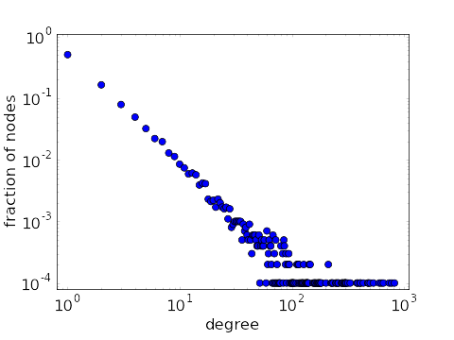
Scale-free Property: Real Networks
Networks whose degree distribution follows power-law are known as scale-free networks
Most real-world networks are found to be scale-free
Degree distribution of a scale-free network
https://mathinsight.org/scale_free_network

Slide 11
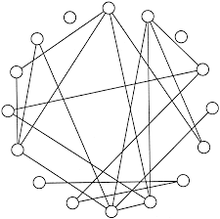
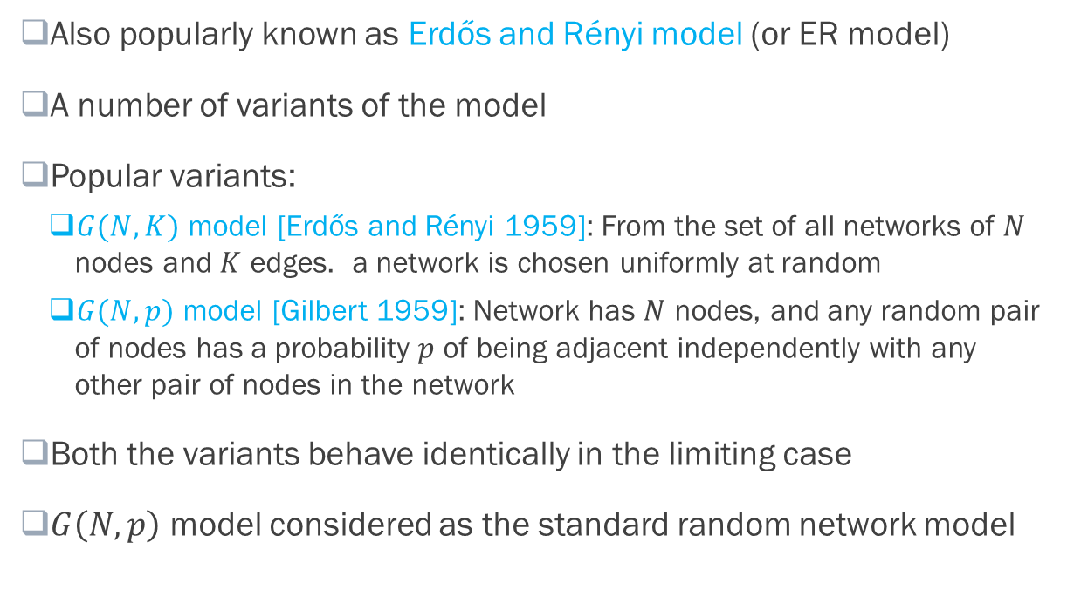
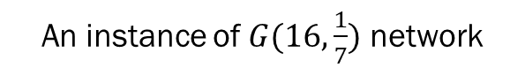
Synthetic Networks: Random Network Model
Also popularly known as Erdős and Rényi model (or ER model)
A number of variants of the model
Popular variants:
$G(N,K)$ model [Erdős and Rényi 1959]: From the set of all networks of $N$ nodes and $K$ edges. a network is chosen uniformly at random
$G(N,p)$ model [Gilbert 1959]: Network has $N$ nodes, and any random pair of nodes has a probability $p$ of being adjacent independently with any other pair of nodes in the network
Both the variants behave identically in the limiting case
$G\left(N,p\right)$ model considered as the standard random network model
An instance of $G(16,\frac{1}{7})$ network

Slide 12
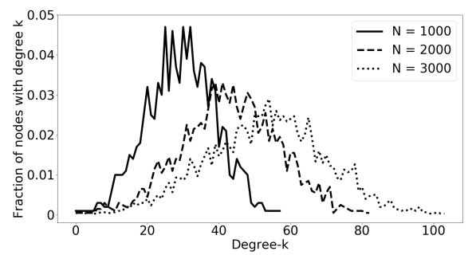
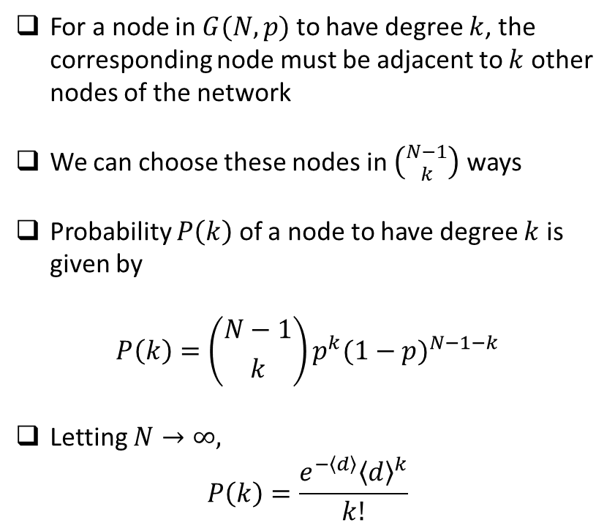
Erdős-Rényi Network: Degree Distribution
For a node in $G(N,p)$ to have degree $k$, the corresponding node must be adjacent to $k$ other nodes of the network
We can choose these nodes in $\left({N−1 \atop k}\right)$ ways
Probability $P\left(k\right)$ of a node to have degree $k$ is given by
$$P\left(k\right)=\left({N−1 \atop k}\right)p^{k}{(1−p)}^{N−1−k}$$
Letting $N→∞,$
$$P\left(k\right)=\frac{e^{−\left\langle d\right\rangle }{\left\langle d\right\rangle }^{k}}{k!}$$
Comparison of degree distribution

Slide 13
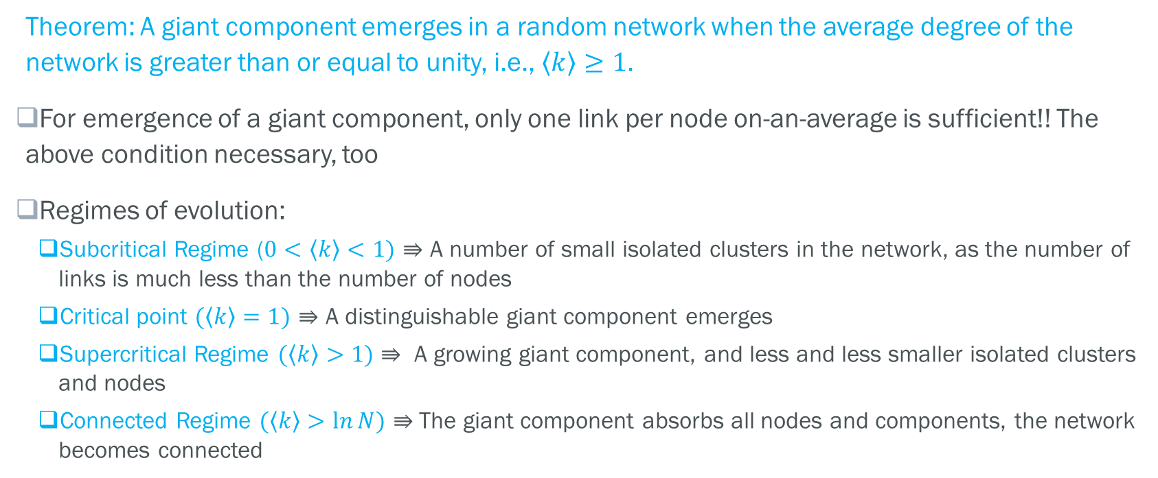
Erdős-Rényi Network: Emergence of Giant Component
Theorem: A giant component emerges in a random network when the average degree of the network is greater than or equal to unity, i.e., $\left\langle k\right\rangle ≥1$.
For emergence of a giant component, only one link per node on-an-average is sufficient!! The above condition necessary, too
Regimes of evolution:
Subcritical Regime ($0<\left\langle k\right\rangle <1)$ $⇛$ A number of small isolated clusters in the network, as the number of links is much less than the number of nodes
Critical point $(\left\langle k\right\rangle =1)$ $⇛$ A distinguishable giant component emerges
Supercritical Regime $(\left\langle k\right\rangle >1)$ $⇛$ A growing giant component, and less and less smaller isolated clusters and nodes
Connected Regime $(\left\langle k\right\rangle >\ln{N})$ $⇛$The giant component absorbs all nodes and components, the network becomes connected

Slide 14
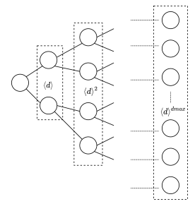
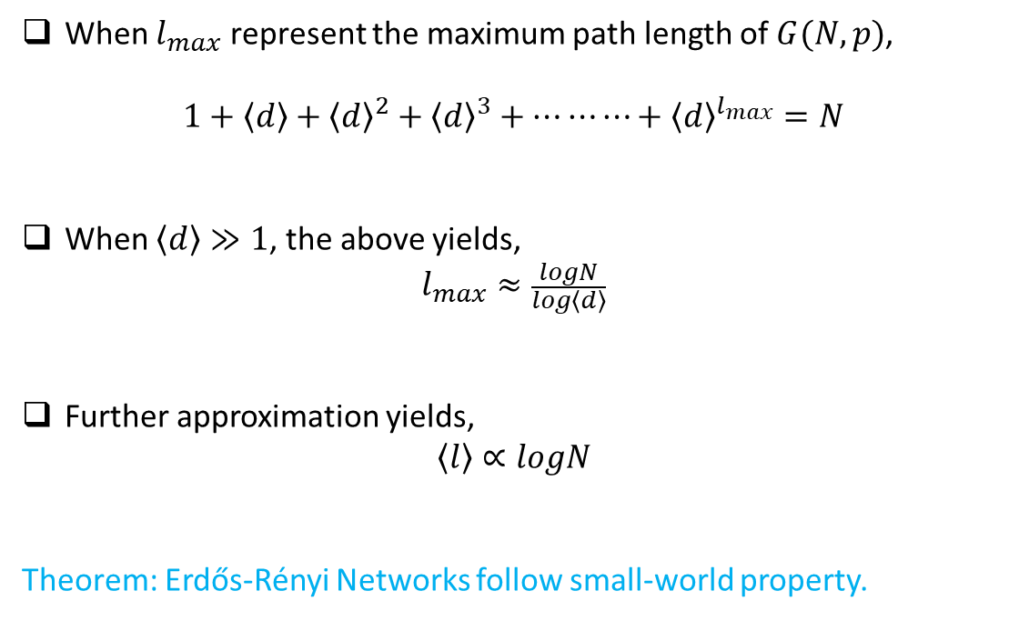
Erdős-Rényi Network: Average Path Length
When $l_{max}$ represent the maximum path length of $G(N,p)$,
$$1+\left\langle d\right\rangle +{\left\langle d\right\rangle }^{2}+{\left\langle d\right\rangle }^{3}+…⋯⋯+{\left\langle d\right\rangle }^{l_{max}}=N$$
When $\left\langle d\right\rangle ≫1$, the above yields,
$$l_{max}≈\frac{logN}{log\left\langle d\right\rangle }$$
Further approximation yields,
$$\left\langle l\right\rangle ∝logN$$
Theorem: Erdős-Rényi Networks follow small-world property.
A depiction of random network in tree format

Slide 15
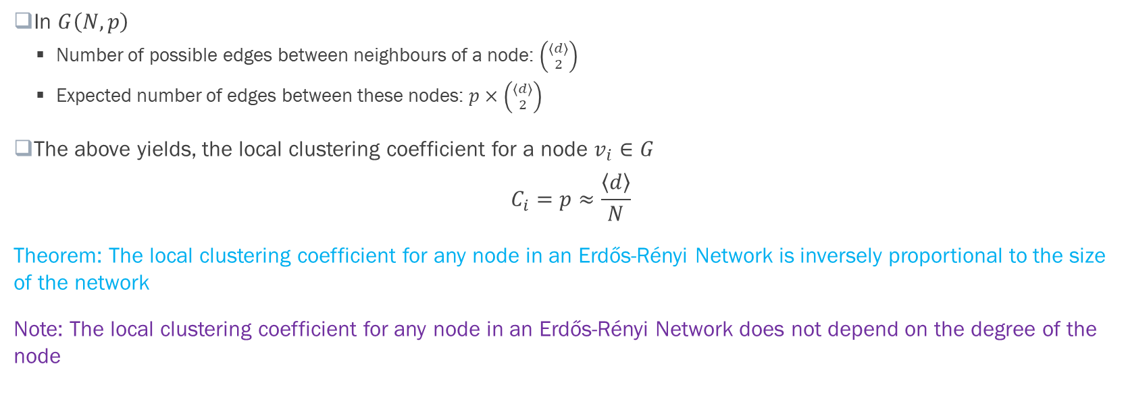
Erdős-Rényi Network: Clustering Coefficient
In $G\left(N,p\right)$
Number of possible edges between neighbours of a node: $\left({\left\langle d\right\rangle \atop 2}\right)$
Expected number of edges between these nodes: $p×\left({\left\langle d\right\rangle \atop 2}\right)$
The above yields, the local clustering coefficient for a node $v_{i}∈G$
$$C_{i}=p≈\frac{\left\langle d\right\rangle }{N}$$
Theorem: The local clustering coefficient for any node in an Erdős-Rényi Network is inversely proportional to the size of the network
Note: The local clustering coefficient for any node in an Erdős-Rényi Network does not depend on the degree of the node

Slide 16
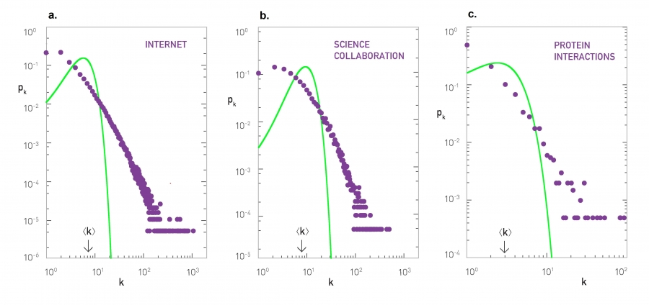
Erdős-Rényi Networks vs. Real-life Networks: Degree Distribution
Real-life networks are often scale-free; however, Erdős-Rényi Networks are not
http://networksciencebook.com/chapter/3#not-poisson

Slide 17
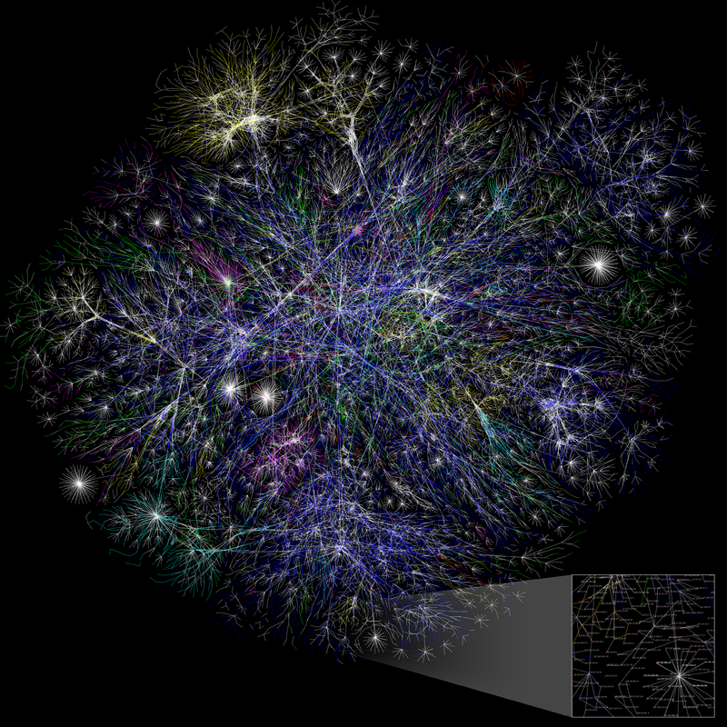
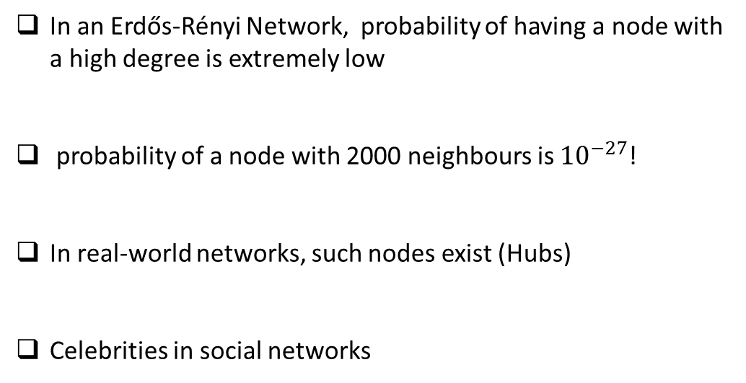
Erdős-Rényi Networks vs. Real-life Networks: Presence of Outliers
In an Erdős-Rényi Network, probability of having a node with a high degree is extremely low
probability of a node with 2000 neighbours is ${10}^{−27}$!
In real-world networks, such nodes exist (Hubs)
Celebrities in social networks
Partial map of the Internet based on the January 15, 2005. Hubs are highlighted
https://en.wikipedia.org/wiki/Hub_(network_science)

Slide 18
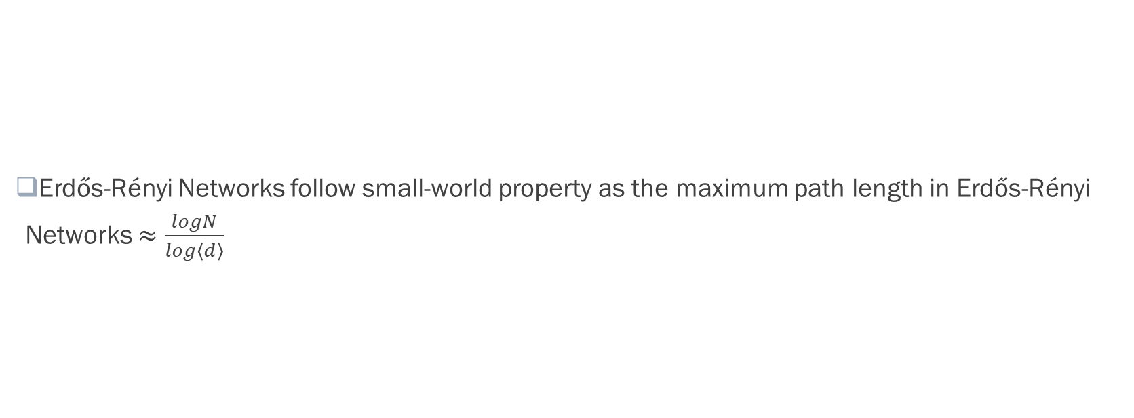
Erdős-Rényi Networks vs. Real-life Networks: Small-world Property
Erdős-Rényi Networks follow small-world property as the maximum path length in Erdős-Rényi Networks $≈\frac{logN}{log\left\langle d\right\rangle }$

Slide 19
Erdős-Rényi Networks vs. Real-life Networks: Clustering Coefficient
local clustering coefficients in Erdős-Rényi Networks decreases with the increase in network size
Nodes having high local clustering coefficient exist in enormously large real-life networks
Echo chambers in large social networks like Facebook

Slide 20
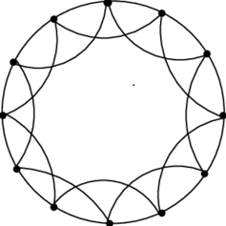
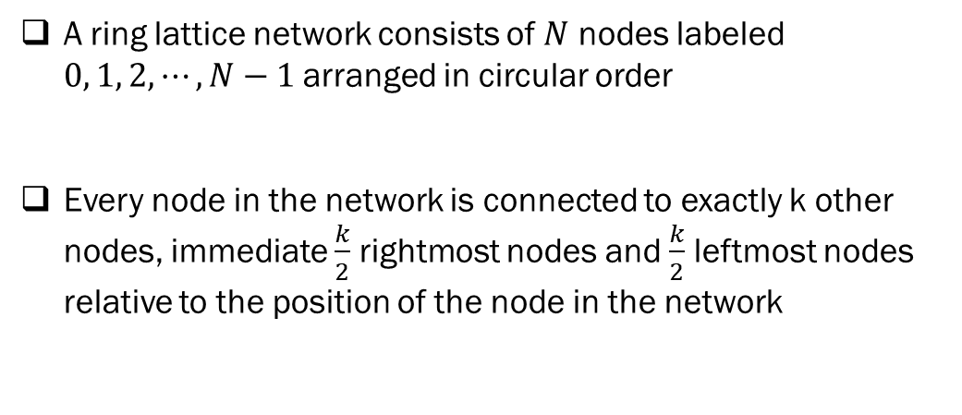
Regular Ring Lattice Network Model
A ring lattice network consists of $N$ nodes labeled $0, 1, 2, ⋯,N−1$arranged in circular order
Every node in the network is connected to exactly k other nodes, immediate $\frac{k}{2}$ rightmost nodes and $\frac{k}{2}$ leftmost nodes relative to the position of the node in the network
4-Regular Ring Lattice Network

Slide 21
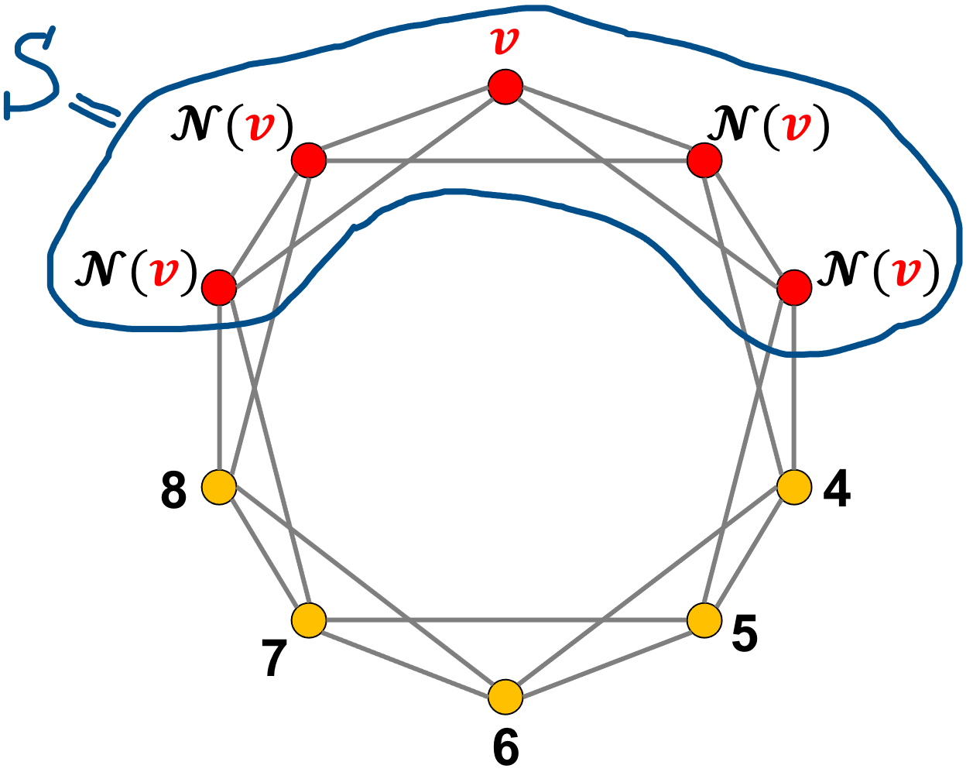
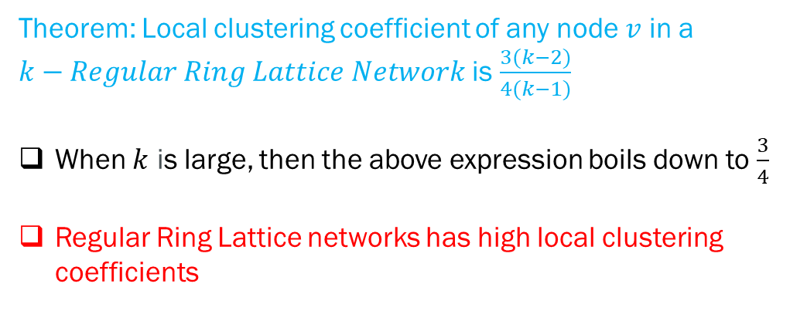
Regular Ring Lattice Network Model: Local Clustering Coefficient
Theorem: Local clustering coefficient of any node $v$ in a
$k−Regular Ring Lattice Network$ is $\frac{3(k−2)}{4(k−1)}$
When $k$ is large, then the above expression boils down to $\frac{3}{4}$
Regular Ring Lattice networks has high local clustering coefficients
4-Regular Ring Lattice Network

Slide 22
Regular Ring Lattice Network Model: Small-world Property
All the connection in ring lattice are to nearby nodes
Two nodes that are in the opposite sides of the ring will be connected by long chains
Theorem: Regular Ring Lattice networks does not follow small-world property
4-Regular Ring Lattice Network

Slide 23
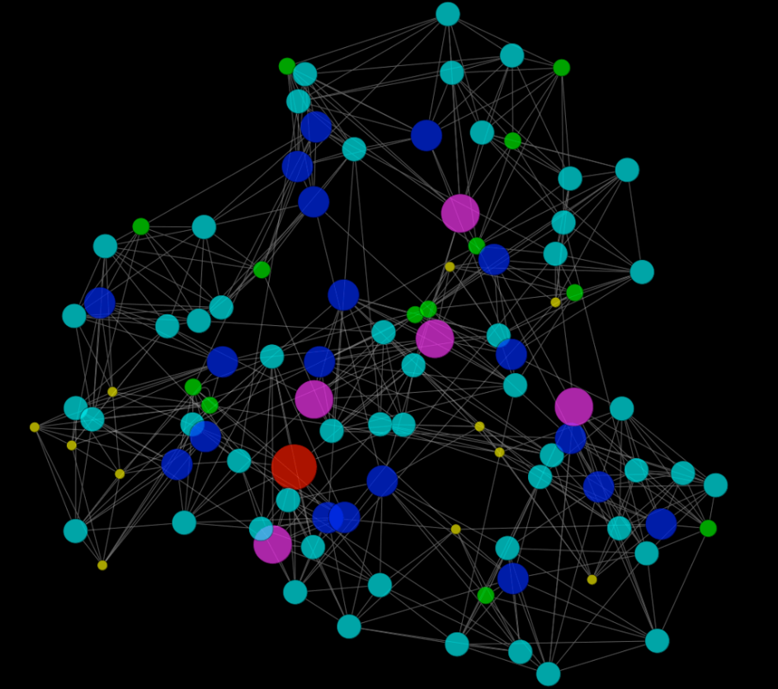
Watts-Strogatz Network Model
Erdős-Rényi Networks
possesses the small-world property,
have small local clustering coefficients for all the nodes when the network size is large
Regular Ring Lattice networks
possess high local clustering coefficients for all the node
does not follow small-world property
Watts-Strogatz Model form networks that has a high local clustering coefficient and possesses the small-world property
Proposed by Watts and Strogatz in 1998
Watts–Strogatz network with 100 nodes formed by igraph and visualized by Cytoscape 2.5
https://en.wikipedia.org/wiki/Watts%E2%80%93Strogatz_model

Slide 24
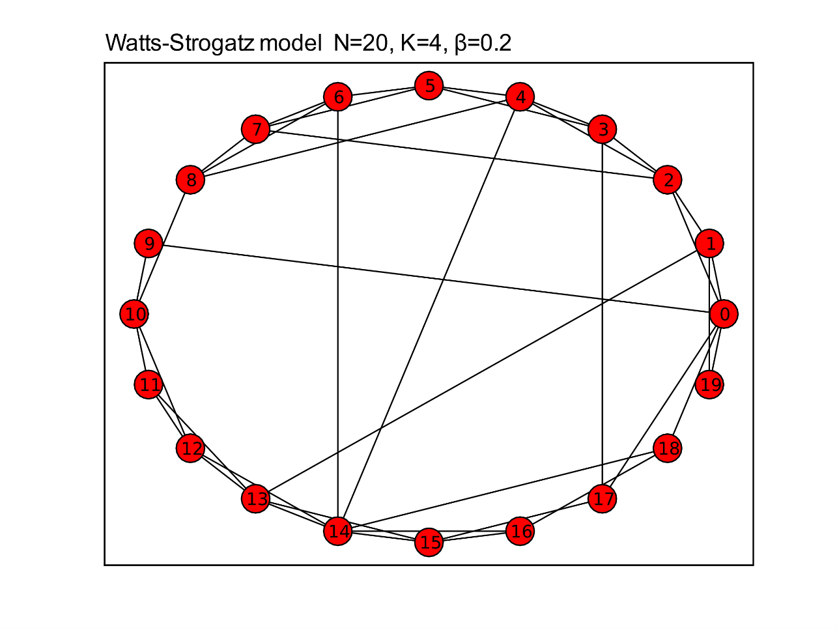
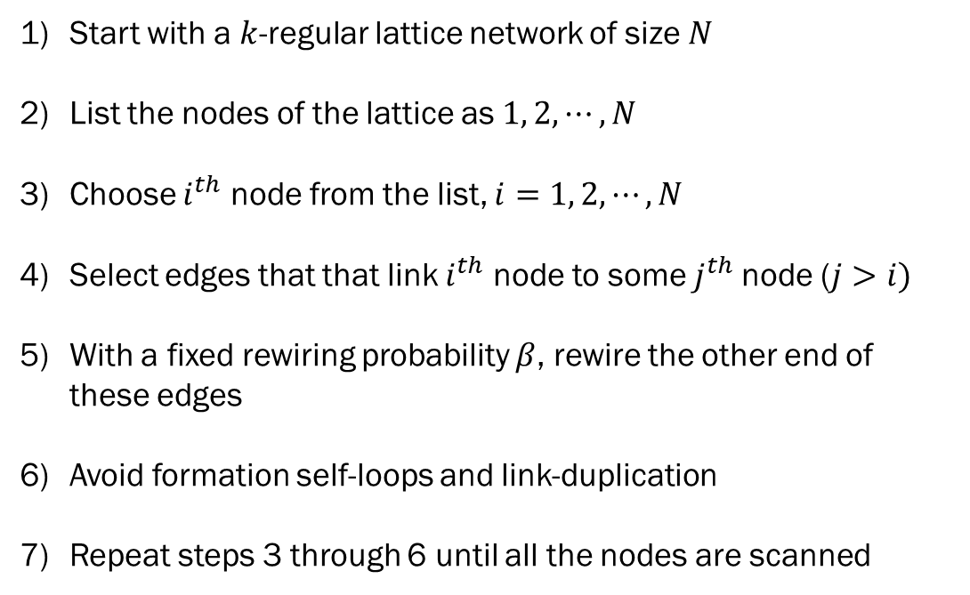
Watts-Strogatz Network Model: Network Formation
Start with a $k$-regular lattice network of size $N$
List the nodes of the lattice as $1, 2, ⋯, N$
Choose $i^{th}$ node from the list, $i=1, 2, ⋯, N$
Select edges that that link $i^{th}$ node to some $j^{th}$node ($j>i)$
With a fixed rewiring probability $β$, rewire the other end of these edges
Avoid formation self-loops and link-duplication
Repeat steps 3 through 6 until all the nodes are scanned
https://www.hindawi.com/journals/mpe/2014/693743/fig2/

Slide 25
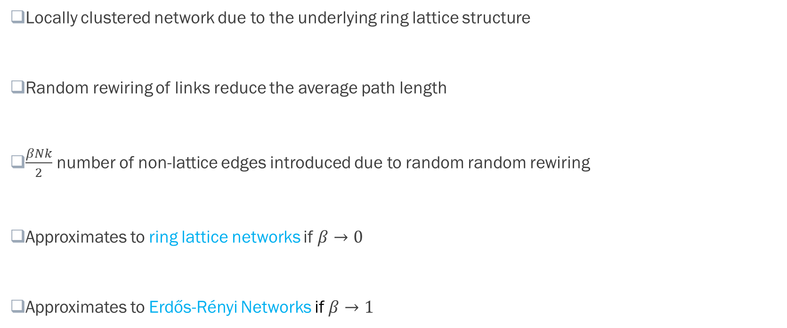
Watts-Strogatz Network Model: Properties
Locally clustered network due to the underlying ring lattice structure
Random rewiring of links reduce the average path length
$\frac{βNk}{2}$ number of non-lattice edges introduced due to random random rewiring
Approximates to ring lattice networks if $β→0$
Approximates to Erdős-Rényi Networks if $β→1$

Slide 26
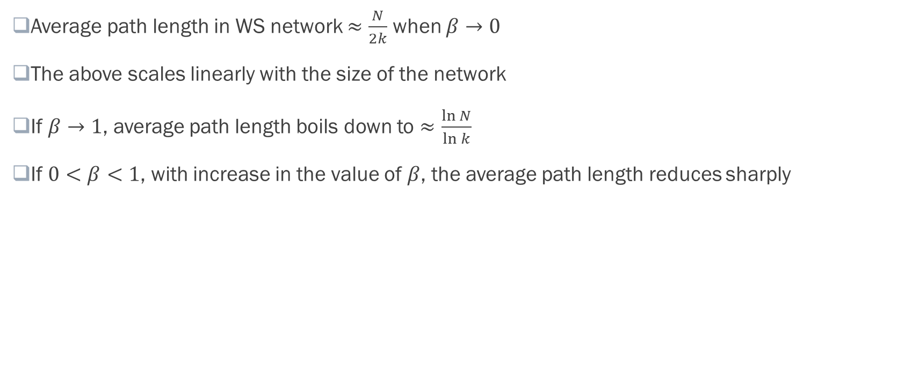
Watts-Strogatz Network Model: Average Path Length
Average path length in WS network $≈\frac{N}{2k}$ when $β→0$
The above scales linearly with the size of the network
If $β→1$, average path length boils down to $≈\frac{\ln{N}}{\ln{k}}$
If $0<β<1$, with increase in the value of $β$, the average path length reduces sharply

Slide 27
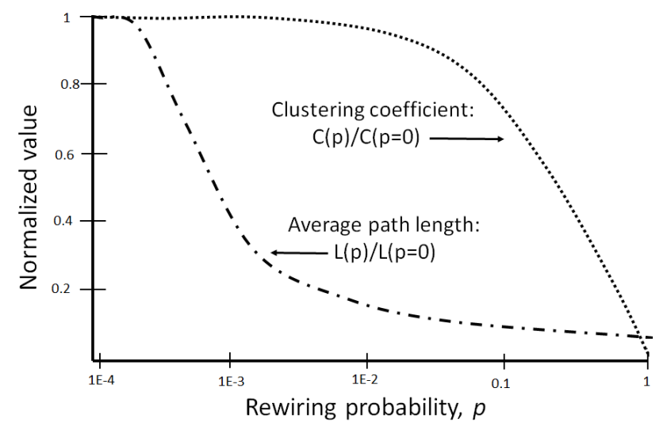
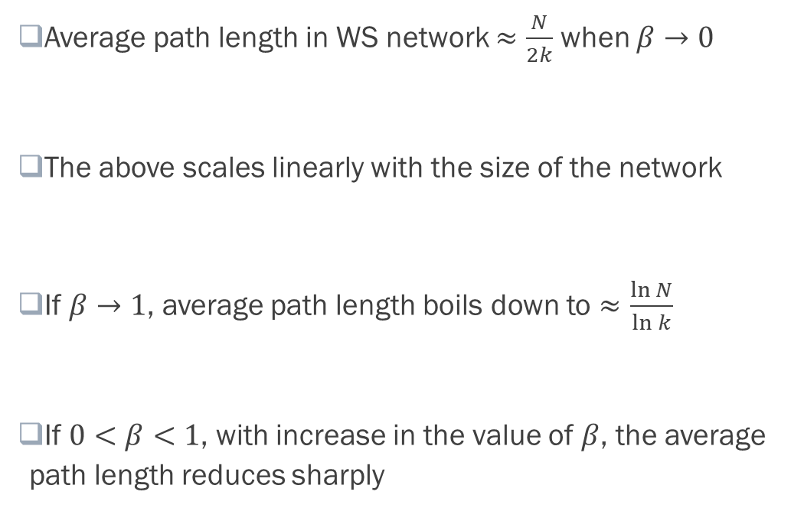
Watts-Strogatz Network Model: Clustering Coefficient
Average path length in WS network $≈\frac{N}{2k}$ when $β→0$
The above scales linearly with the size of the network
If $β→1$, average path length boils down to $≈\frac{\ln{N}}{\ln{k}}$
If $0<β<1$, with increase in the value of $β$, the average path length reduces sharply
𝛽→0

Slide 28
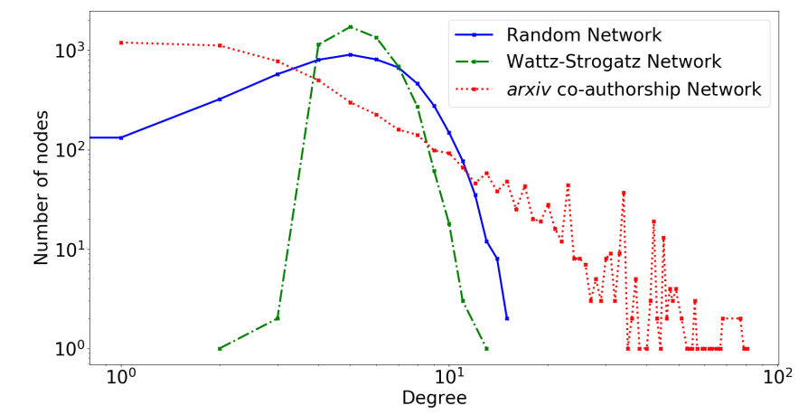
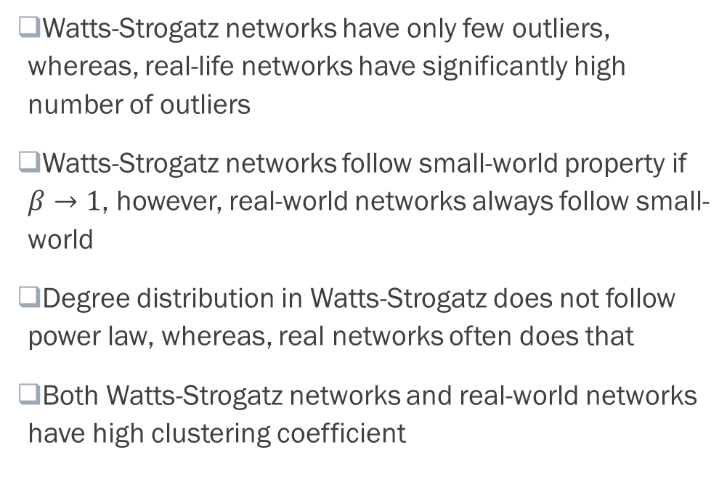
Watts-Strogatz Networks vs. Real-world Networks
Watts-Strogatz networks have only few outliers, whereas, real-life networks have significantly high number of outliers
Watts-Strogatz networks follow small-world property if $β→1$, however, real-world networks always follow small-world
Degree distribution in Watts-Strogatz does not follow power law, whereas, real networks often does that
Both Watts-Strogatz networks and real-world networks have high clustering coefficient
Comparisons of Degree Distribution

Slide 29
Barabasi-Albert Network Model
Real-life social networks often evolve with time
Originates with a small seed network
The network grows as new nodes and edges gets attached to the network with time
Barabasi-Albert model follows the same principle of network evolution
Also known as Preferential Attachment model or rich gets richer model
Generates scale-free networks

Slide 30
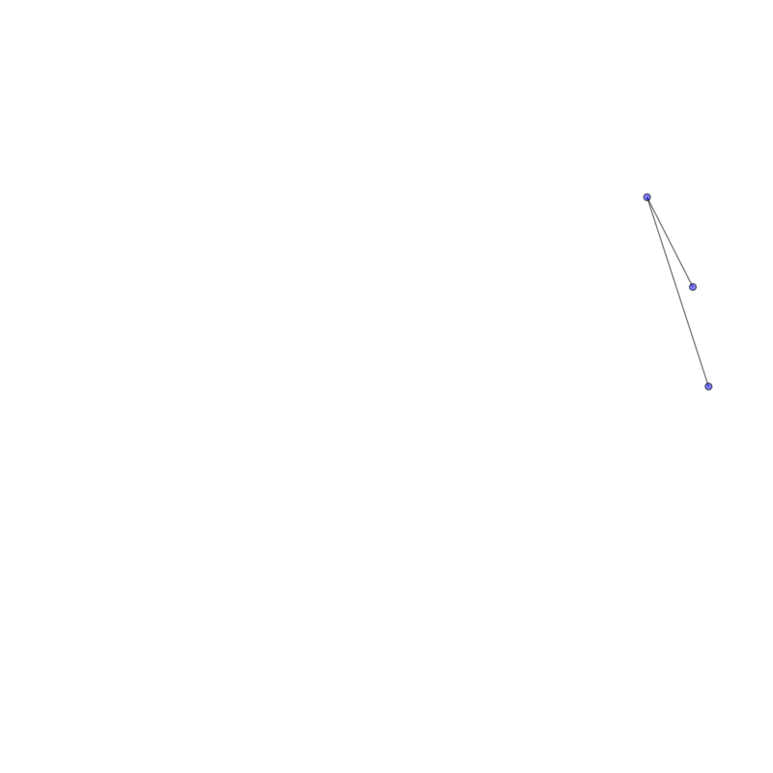
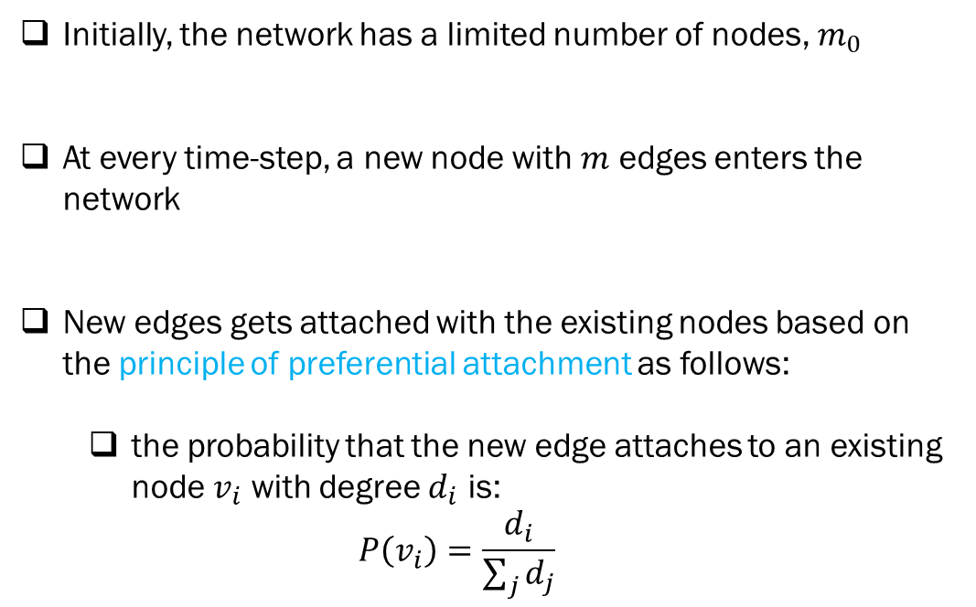
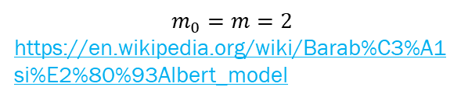
Barabasi-Albert Model: Network Formation
Initially, the network has a limited number of nodes, $m_{0}$
At every time-step, a new node with $m$ edges enters the network
New edges gets attached with the existing nodes based on the principle of preferential attachment as follows:
the probability that the new edge attaches to an existing node $v_{i}$ with degree $d_{i}$ is:
$$P\left(v_{i}\right)=\frac{d_{i}}{\sum_{j}{d_{j}}}$$
$$m_{0}=m=2$$
https://en.wikipedia.org/wiki/Barab%C3%A1si%E2%80%93Albert_model

Slide 31
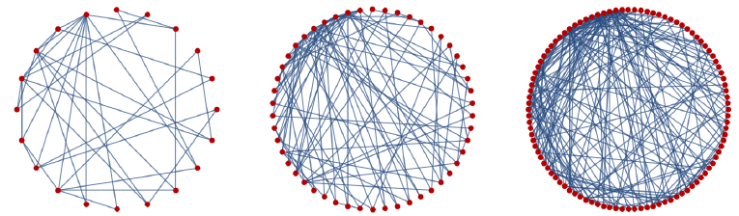
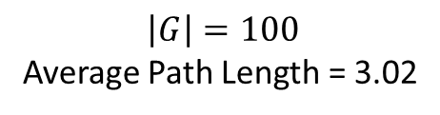
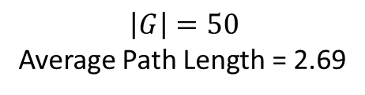
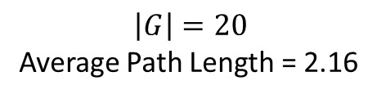
Barabasi-Albert Model: Network Growth
$$\left|G\right|=20$$
Average Path Length = 2.16
$$\left|G\right|=50$$
Average Path Length = 2.69
$$\left|G\right|=100$$
Average Path Length = 3.02
https://www.researchgate.net/publication/259742981_Information_Theory_Kolmogorov_Complexity_and_Algorithmic_Probability_in_Network_Biology

Slide 32
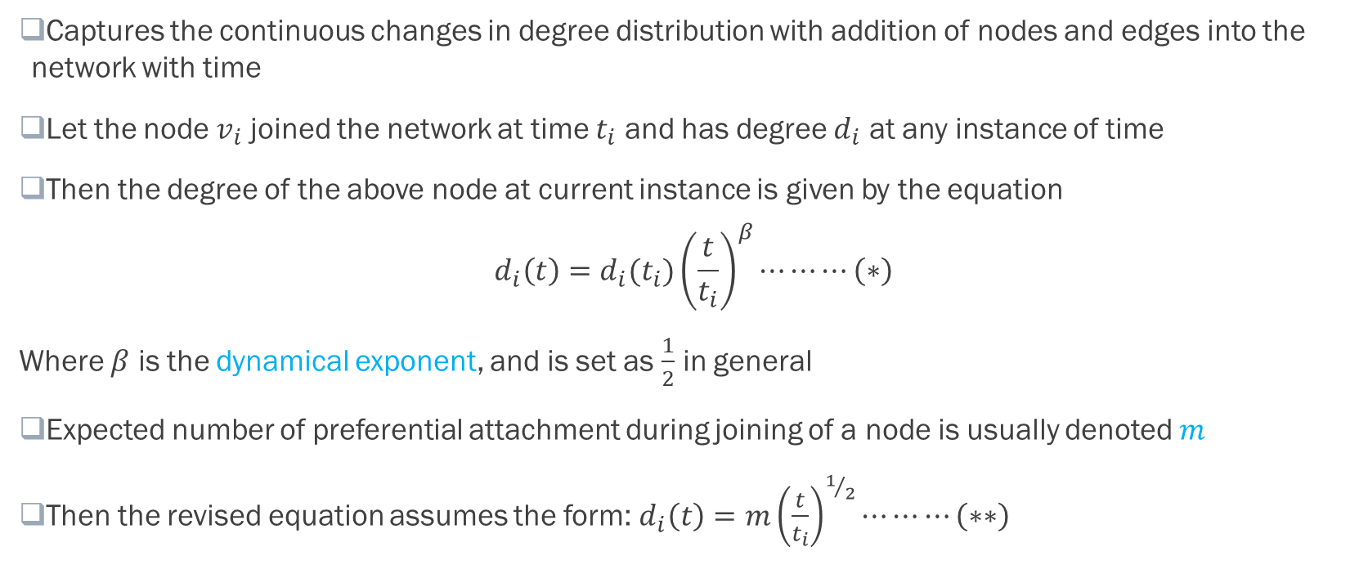
Barabasi-Albert Model: Degree Dynamics
Captures the continuous changes in degree distribution with addition of nodes and edges into the network with time
Let the node $v_{i}$ joined the network at time $t_{i}$ and has degree $d_{i}$ at any instance of time
Then the degree of the above node at current instance is given by the equation
$$d_{i}\left(t\right)=d_{i}(t_{i}){\left(\frac{t}{t_{i}}\right)}^{β}⋯⋯⋯\left(∗\right)$$
Where $β$ is the dynamical exponent, and is set as $\frac{1}{2}$ in general
Expected number of preferential attachment during joining of a node is usually denoted $m$
Then the revised equation assumes the form:$d_{i}\left(t\right)=m{\left(\frac{t}{t_{i}}\right)}^{1/2}⋯⋯⋯\left(∗∗\right)$

Slide 33
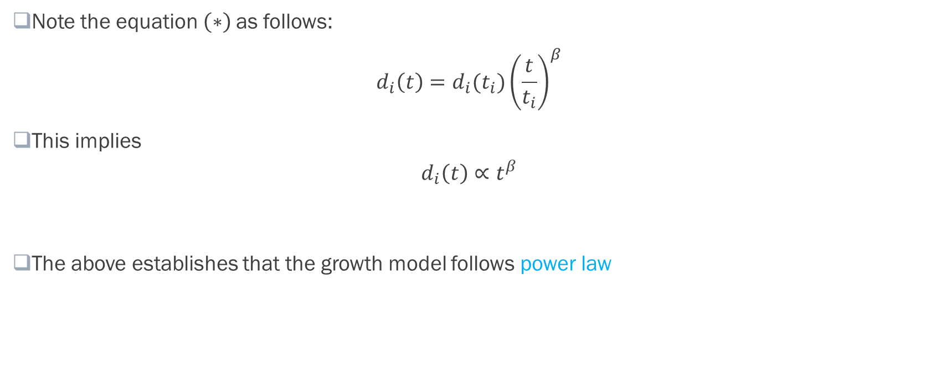
Barabasi-Albert Model: Scale-free Property
Note the equation $\left(∗\right)$as follows:
$$d_{i}\left(t\right)=d_{i}(t_{i}){\left(\frac{t}{t_{i}}\right)}^{β}$$
This implies
$$d_{i}\left(t\right)∝t^{β}$$
The above establishes that the growth model follows power law

Slide 34
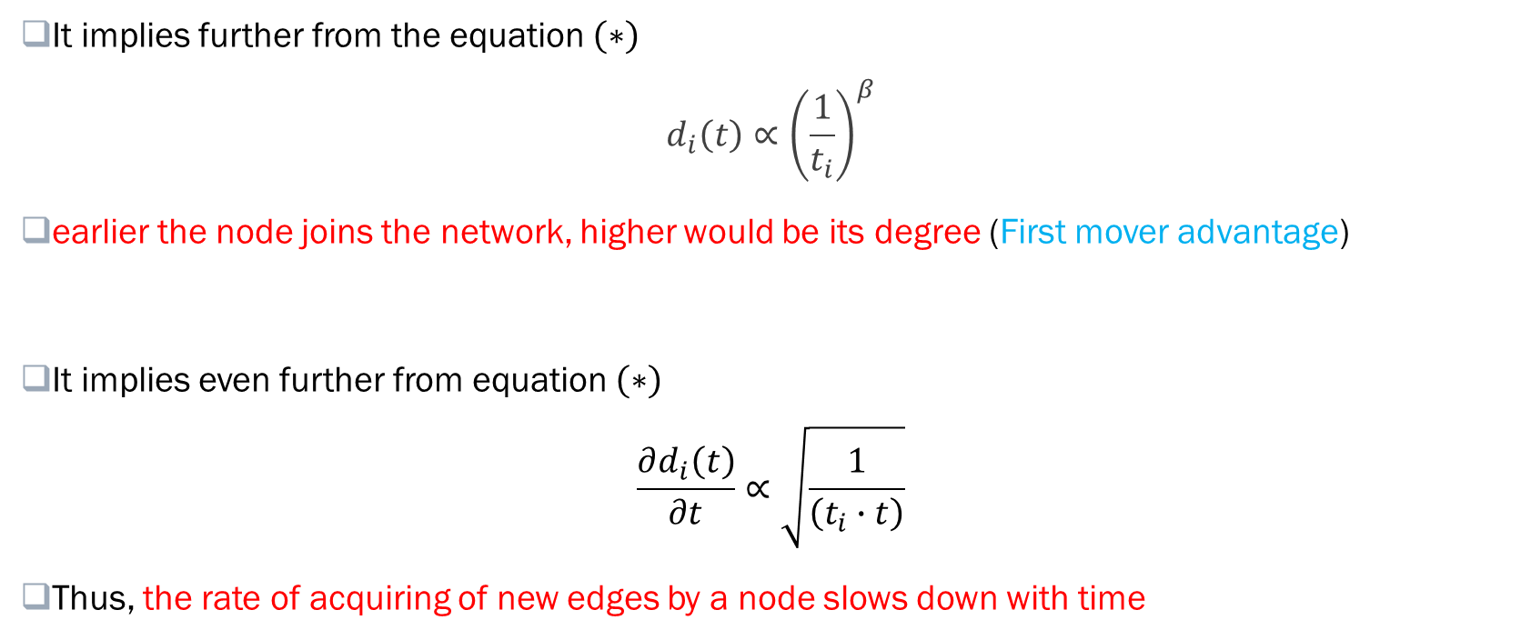
Barabasi-Albert Model: Scale-free Property
It implies further from the equation $\left(∗\right)$
$$d_{i}\left(t\right)∝{\left(\frac{1}{t_{i}}\right)}^{β}$$
earlier the node joins the network, higher would be its degree (First mover advantage)
It implies even further from equation $\left(∗\right)$
$$\frac{∂d_{i}\left(t\right)}{∂t}∝\sqrt{\frac{1}{\left(t_{i}∙t\right)}}$$
Thus, the rate of acquiring of new edges by a node slows down with time

Slide 35
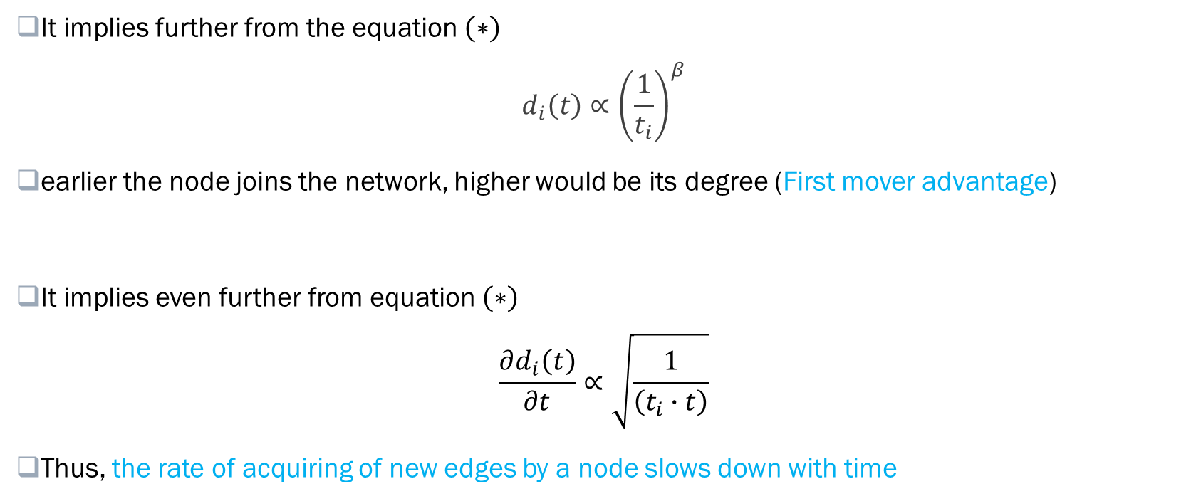
Barabasi-Albert Model: Scale-free Property
It implies further from the equation $\left(∗\right)$
$$d_{i}\left(t\right)∝{\left(\frac{1}{t_{i}}\right)}^{β}$$
earlier the node joins the network, higher would be its degree (First mover advantage)
It implies even further from equation $\left(∗\right)$
$$\frac{∂d_{i}\left(t\right)}{∂t}∝\sqrt{\frac{1}{\left(t_{i}∙t\right)}}$$
Thus, the rate of acquiring of new edges by a node slows down with time

Slide 36
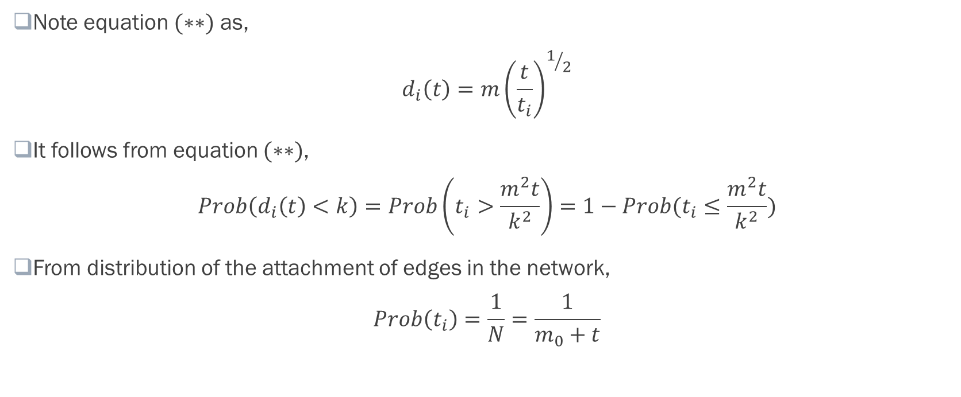
Barabasi-Albert Model: Scale-free Property
Note equation $(∗∗)$ as,
$$d_{i}\left(t\right)=m{\left(\frac{t}{t_{i}}\right)}^{1/2}$$
It follows from equation $(∗∗)$,
$$Prob\left(d_{i}\left(t\right)<k\right)=Prob\left(t_{i}>\frac{m^{2}t}{k^{2}}\right)=1−Prob(t_{i}≤\frac{m^{2}t}{k^{2}})$$
From distribution of the attachment of edges in the network,
$$Prob\left(t_{i}\right)=\frac{1}{N}=\frac{1}{m_{0}+t}$$

Slide 37
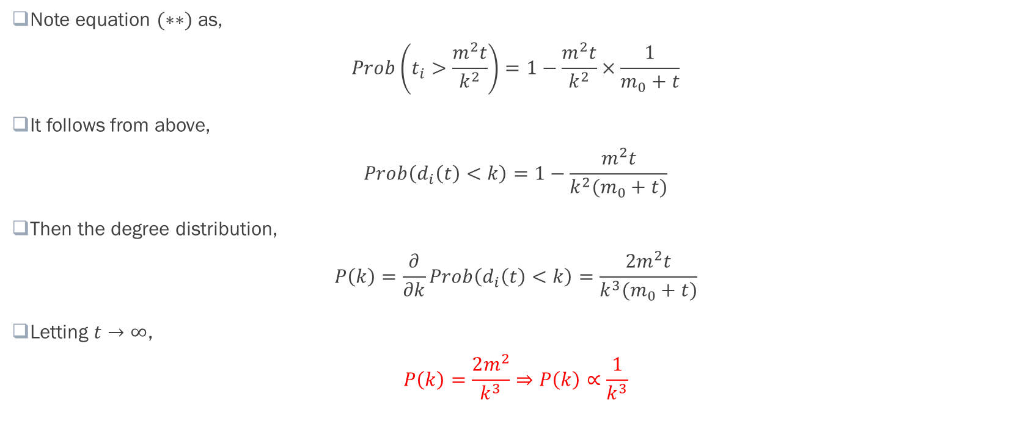
Barabasi-Albert Model: Scale-free Property
Note equation $(∗∗)$ as,
$$Prob\left(t_{i}>\frac{m^{2}t}{k^{2}}\right)=1−\frac{m^{2}t}{k^{2}}×\frac{1}{m_{0}+t}$$
It follows from above,
$$Prob\left(d_{i}\left(t\right)<k\right)=1−\frac{m^{2}t}{k^{2}(m_{0}+t)}$$
Then the degree distribution,
$$P\left(k\right)=\frac{∂}{∂k}Prob\left(d_{i}\left(t\right)<k\right)=\frac{{2m}^{2}t}{k^{3}(m_{0}+t)}$$
Letting $t→∞$,
$$P\left(k\right)=\frac{2m^{2}}{k^{3}}⇒P\left(k\right)∝\frac{1}{k^{3}}$$

Slide 38
Barabasi-Albert Model: Limitations
Model assumes that only one node is added at a time; difficult to apply if more than one node arrive simultaneously
Assumes a linear growth model; may not be realistic in many applications
Predicts a fixed exponent in the power-law degree distribution; whereas, across real-world networks, exponent varies between 1 and 3
Model does not capture the temporal decay of preference of a node
Model does not consider the competitive characteristics of a real-world node that flourish in short notice

